Slide 1
CSCI 475/585 Information Security and Privacy Fall 2019
Chapter 2 – Cryptographic Tools
Week 2
2.1 Symmetric Encryption
Notes:
Lecture slides prepared by Dr Lawrie Brown (UNSW@ADFA) for “Computer Security: Principles and Practice”, by William Stallings and Lawrie Brown, Chapter 2 “Cryptographic Tools”.
Enhanced and Modified by Chuan Yue at the Colorado School of Mines.

Slide 2
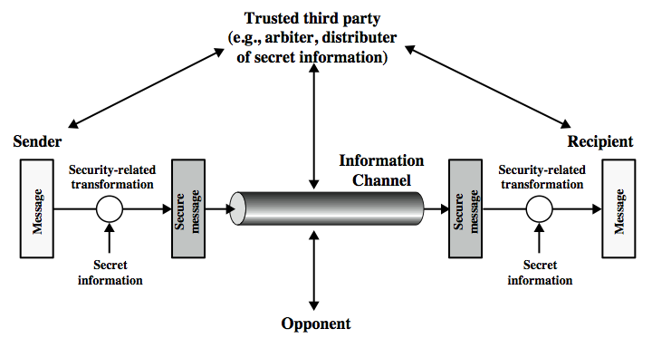
Model for Network Security
Notes:
Chuan: The model that we consider in CSCI474/574.
In considering the place of encryption, its useful to use the following two models from Stallings section 1.6.
The first, illustrated in Figure 1.4, models information being transferred from one party to another over an insecure communications channel, in the presence of possible opponents. The two parties, who are the principals in this transaction, must cooperate for the exchange to take place.
Security aspects come into play when it is necessary or desirable to protect the information transmission from an opponent who may present a threat to confidentiality, integrity, and so on. All the techniques for providing security have two components:
A security-related transformation on the information to be sent.
Some secret information shared by the two principals and, it is hoped, unknown to the opponent.
They can use an appropriate security transform (encryption algorithm), with suitable keys, possibly negotiated using the presence of a trusted third party. Parts One through Four of this book concentrates on the types of security mechanisms and services that fit into the model shown here.

Slide 3
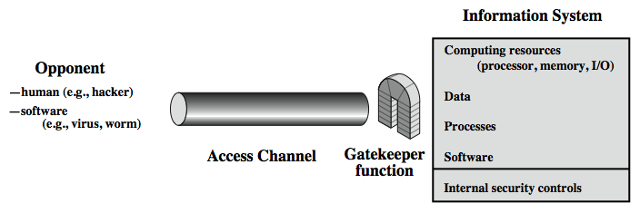
Model for Network Access Security
Notes:
Chuan: The model that we consider in CSCI475/585.
The second, illustrated in Figure 1.5, model is concerned with controlled access to information or resources on a computer system, in the presence of possible opponents. Here appropriate controls are needed on the access to and within the system, to provide suitable security.
The security mechanisms needed to cope with unwanted access fall into two broad categories (as shown in this figure). The first category might be termed a gatekeeper function. (Chuan: talk about the four authentication factors). It includes password-based login procedures that are designed to deny access to all but authorized users and screening logic that is designed to detect and reject worms, viruses, and other similar attacks. Once either an unwanted user or unwanted software gains access, the second line of defense consists of a variety of internal controls that monitor activity and analyze stored information in an attempt to detect the presence of unwanted intruders. These issues are explored in Part Four.

Slide 4
Some Basic Terminology
plaintext - original message
ciphertext - coded message
cipher - algorithm for transforming plaintext to ciphertext
key - info used in cipher known only to sender/receiver
encipher (encrypt) - converting plaintext to ciphertext
decipher (decrypt) - recovering ciphertext from plaintext
cryptography - study of encryption principles/methods
cryptanalysis (codebreaking) - study of principles/ methods of deciphering ciphertext without knowing key
cryptology - field of both cryptography and cryptanalysis

Slide 5
Cryptography
Ron Rivest on Cryptography
https://www.youtube.com/watch?v=8K1RapDozuw
can characterize cryptographic systems by:
type of encryption operations used
substitution
transposition
Multiple stages of substitutions and transpositions
number of keys used
single-key, secret-key, or symmetric
two-key, public, or asymmetric
way in which plaintext is processed
block
stream
Notes:
Enhanced and Modified by Chuan Yue at the Colorado School of Mines.
Cryptographic systems can be characterized along these three independent dimensions.
The type of operations used for transforming plaintext to ciphertext. All encryption algorithms are based on two general principles: substitution, in which each element in the plaintext (bit, letter, group of bits or letters) is mapped into another element, and transposition, in which elements in the plaintext are rearranged. The fundamental requirement is that no information be lost (that is, that all operations are reversible). Most systems, referred to as product systems, involve multiple stages of substitutions and transpositions.
The number of keys used. If both sender and receiver use the same key, the system is referred to as symmetric, single-key, secret-key, or conventional encryption. If the sender and receiver use different keys, the system is referred to as asymmetric, two-key, or public-key encryption.
The way in which the plaintext is processed. A block cipher processes the input one block of elements at a time, producing an output block for each input block. A stream cipher processes the input elements continuously, producing output one element at a time, as it goes along.

Slide 6
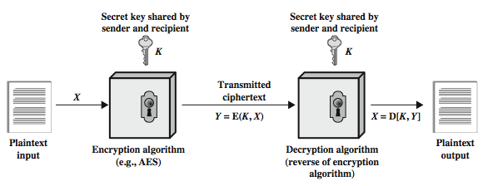
Symmetric Cipher Model
two requirements for secure use of symmetric encryption:
a strong encryption algorithm
a secret key known only to sender / receiver
assume en(de)cryption algorithm is known
implies a secure channel to distribute key
Notes:
Detail the five ingredients of the symmetric cipher model, shown in Stallings Figure 2.1:
plaintext - original message
encryption algorithm – performs substitutions/transformations on plaintext
secret key – control exact substitutions/transformations used in encryption algorithm
ciphertext - scrambled message
decryption algorithm – inverse of encryption algorithm
There are two requirements for secure use of conventional encryption that mean we assume that it is impractical to decrypt a message on the basis of the cipher- text plus knowledge of the encryption/decryption algorithm, and hence do not need to keep the algorithm secret; rather we only need to keep the key secret. This feature of symmetric encryption is what makes it feasible for widespread use. It allows easy distribution of s/w and h/w implementations.
Can take a closer look at the essential elements of a symmetric encryption scheme: mathematically it can be considered a pair of functions with: plaintext X, ciphertext Y, key K, encryption algorithm E, decryption algorithm D. The intended receiver, in possession of the key, is able to invert the transformation. An opponent, observing Y but not having access to K or X, may attempt to recover X or K.

Slide 7
Attacking Symmetric Encryption
cryptanalytic attacks
rely on nature of the algorithm
plus some knowledge of plaintext characteristics
even some sample plaintext-ciphertext pairs
exploits characteristics of algorithm to deduce specific plaintext or key
brute-force attacks
try all possible keys on some ciphertext until get an intelligible translation into plaintext
Notes:
There are two general approaches to attacking a symmetric encryption scheme. The first attack is known as cryptanalysis. Cryptanalytic attacks rely on the nature of the algorithm plus perhaps some knowledge of the general characteristics of the plaintext or even some sample plaintext-ciphertext pairs. This type of attack exploits the characteristics of the algorithm to attempt to deduce a specific plaintext or to deduce the key being used. If the attack succeeds in deducing the key, the effect is catastrophic: All future and past messages encrypted with that key are compromised. The second method, known as the brute-force attack, is to try every possible key on a piece of ciphertext until an intelligible translation into plaintext is obtained. On average, half of all possible keys must be tried to achieve success.

Slide 8
Cryptanalytic Attacks
ciphertext only
only know algorithm & ciphertext
known plaintext (an encryption algorithm should withstand)
Know some plaintext/ciphertext pairs
e.g., Postscript format files, message headers
chosen plaintext
select plaintext and obtain ciphertext
chosen ciphertext
select ciphertext and obtain plaintext
chosen text
select plaintext or ciphertext to en/decrypt
Notes:
Added by Chuan Yue at the Colorado School of Mines.

Slide 9
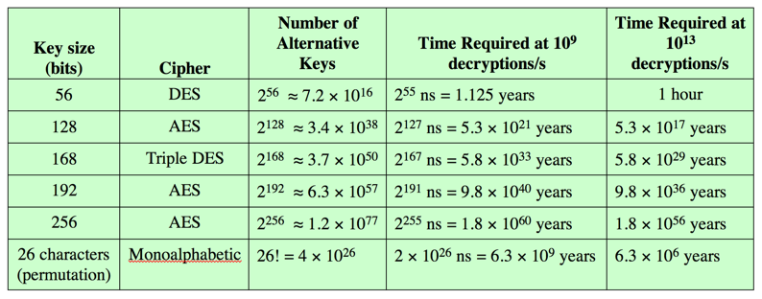
Brute Force Search
always possible to simply try every key
most basic attack, proportional to key size
on average, half of the key space must be tried
assume either know / recognize plaintext
Notes:
A brute-force attack involves trying every possible key until an intelligible translation of the ciphertext into plaintext is obtained. On average, half of all possible keys must be tried to achieve success. Stallings Table 2.2 shows how much time is required to conduct a brute-force attack, for various common key sizes (DES is 56, AES is 128, Triple-DES is 168, plus general mono-alphabetic cipher), where either a single system or a million parallel systems, are used. In terms of the number of decryptions in per microsecond.
Chuan: The Table 3.5 (chapter 3, page 78, and 6th edition) of this textbook shows that a rate of 1 billion (10^9 ) decryptions per second can be achieved by today’s multicore computers.

Slide 10
Classical Substitution Ciphers
where letters of plaintext are replaced by other letters or by numbers or symbols
or if plaintext is viewed as a sequence of bits, then substitution involves replacing plaintext bit patterns with ciphertext bit patterns
Notes:
In this section and the next, we examine a sampling of what might be called classical encryption techniques. A study of these techniques enables us to illustrate the basic approaches to symmetric encryption used today and the types of cryptanalytic attacks that must be anticipated. The two basic building blocks of all encryption technique are substitution and transposition. We examine these in the next two sections. Finally, we discuss a system that combine both substitution and transposition.
A substitution technique is one in which the letters of plaintext are replaced by other letters or by numbers or symbols. If the plaintext is viewed as a sequence of bits, then substitution involves replacing plaintext bit patterns with ciphertext bit patterns.

Slide 11
Caesar Cipher
earliest known substitution cipher
by Julius Caesar (a Roman general)
first attested use in military affairs
replaces each letter with the letter 3 places further down the alphabet
example:
meet me after the toga party
PHHW PH DIWHU WKH WRJD SDUWB
Notes:
Substitution ciphers form the first of the fundamental building blocks. The core idea is to replace one basic unit (letter/byte) with another. Whilst the early Greeks described several substitution ciphers, the first attested use in military affairs of one was by Julius Caesar, described by him in Gallic Wars (cf. Kahn pp83-84). Still call any cipher using a simple letter shift a caesar cipher, not just those with shift 3.

Slide 12
Caesar Cipher
can define transformation as:
a b c d e f g h i j k l m n o p q r s t u v w x y z
D E F G H I J K L M N O P Q R S T U V W X Y Z A B C
mathematically give each letter a number
a b c d e f g h i j k l m n o p q r s t u v w x y z
0 1 2 3 4 5 6 7 8 9 10 11 12 13 14 15 16 17 18 19 20 21 22 23 24 25
then have the general form of Caesar cipher:
c = E(k, p) = (p + k) mod (26)
p = D(k, c) = (c – k) mod (26)
key is 1 letter long
Notes:
This mathematical description uses modulo (clock) arithmetic. Here, when you reach Z you go back to A and start again. Mod 26 implies that when you reach 26, you use 0 instead (ie the letter after Z, or 25 + 1 goes to A or 0).
Example: howdy (7,14,22,3,24) encrypted using key f (ie a shift of 5) is MTBID
Chuan: mention the mudulo operation.

Slide 13
Cryptanalysis of Caesar Cipher
encryption and decryption algorithms are known
only have 26 possible ciphers
A maps to A,B,..Z
a brute force search, could simply try each in turn
do need to recognize when have plaintext
eg. break ciphertext "GCUA VQ DTGCM“
language of the plaintext is known and easily recognizable
Notes:
With a caesar cipher, there are only 26 possible keys, of which only 25 are of any use, since mapping A to A etc doesn't really obscure the message! Note this basic rule of cryptanalysis "check to ensure the cipher operator hasn't goofed and sent a plaintext message by mistake"!
Can try each of the keys (shifts) in turn, until can recognise the original message.
Note: as mentioned before, do need to be able to recognise when have an original message (ie is it English or whatever). Usually easy for humans, hard for computers. Though if using say compressed data could be much harder.
Example "GCUA VQ DTGCM" when broken gives "easy to break", with a shift of 2 (key C).

Slide 14
Monoalphabetic Cipher
rather than just shifting the alphabet
could shuffle (jumble) the letters arbitrarily
each plaintext letter maps to a different random ciphertext letter
key is 26 letters long
One Mapping:
abcdefghijklmnopqrstuvwxyz
DKVQFIBJWPESCXHTMYAUOLRGZN
Plaintext: ifwewishtoreplaceletters
Ciphertext: WIRFRWAJUHYFTSDVFSFUUFYA
Notes:
With only 26 possible keys, the Caesar cipher is far from secure. A dramatic increase in the key space can be achieved by allowing an arbitrary substitution, where the translation alphabet can be any permutation of the 26 alphabetic characters. A permutation of a finite set of elements S is an ordered sequence of all the elements of S, with each element appearing exactly once. In general, there are n! permutations of a set of n elements.
See text example of a translation alphabet, and an encrypted message using it.

Slide 15
Monoalphabetic Cipher Security
now have a total of 26! = 4 x 10²⁶ keys
permutation
key space: 10 orders of magnitude greater than DES
with so many keys, might think it is secure
but would be !!!WRONG!!!
problem is language characteristics
letters are not equally commonly used
in English E is by far the most common letter
followed by T,R,N,I,O,A,S
other letters like Z,J,K,Q,X are fairly rare
Notes:
Note that even given the very large number of keys, being 10 orders of magnitude greater than the key space for DES, the monoalphabetic substitution cipher is not secure, because it does not sufficiently obscure the underlying language characteristics.

Slide 16
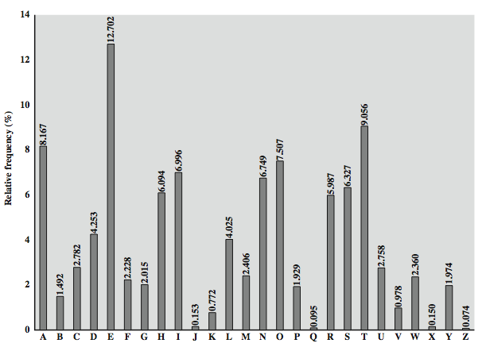
English Letter Frequencies
Also useful are frequencies of common two-letter combinations, known as digrams, and three-letter combinations, known as trigrams.
Common libraries exist for single, double, triple, etc. occurrences in a particular language.
Notes:
Added by Chuan Yue at the Colorado School of Mines.

Slide 17
Use in Cryptanalysis
key concept - monoalphabetic substitution ciphers do not change relative letter frequencies
discovered by Arabian scientists in 9th century
calculate letter frequencies for ciphertext
compare counts/plots against known values
for monoalphabetic must identify each letter
tables of common double/triple letters help
the most frequent trigram is “the”
Notes:
The simplicity and strength of the monoalphabetic substitution cipher meant it dominated cryptographic use for the first millenium AD. It was broken by Arabic scientists. The earliest known description is in Abu al-Kindi's "A Manuscript on Deciphering Cryptographic Messages", published in the 9th century but only rediscovered in 1987 in Istanbul, but other later works also attest to their knowledge of the field. Monoalphabetic ciphers are easy to break because they reflect the frequency data of the original alphabet. The cryptanalyst looks for a mapping between the observed pattern in the ciphertext, and the known source language letter frequencies. If English, look for peaks at: A-E-I triple, NO pair, RST triple, and troughs at: JK, X-Z.
Monoalphabetic ciphers are easy to break because they reflect the frequency data of the original alphabet.

Slide 18
Transposition Ciphers
now consider classical transposition or permutation ciphers
these hide the message by rearranging the letter order
without altering the actual letters used
can recognise these since have the same frequency distribution as the original text
Notes:
All the techniques examined so far involve the substitution of a ciphertext symbol for a plaintext symbol. A very different kind of mapping is achieved by performing some sort of permutation on the plaintext letters. This technique is referred to as a transposition cipher, and form the second basic building block of ciphers. The core idea is to rearrange the order of basic units (letters/bytes/bits) without altering their actual values.

Slide 19
Rail Fence cipher
write message letters out diagonally over a number of rows
then read off cipher row by row
eg. write message out as:
m e m a t r h t g p r y
e t e f e t e o a a t
giving ciphertext
MEMATRHTGPRYETEFETEOAAT
Notes:
The simplest such cipher is the rail fence technique, in which the plaintext is written down as a sequence of diagonals and then read off as a sequence of rows.
The example message is: "meet me after the toga party" with a rail fence of depth 2.
This sort of thing would be trivial to cryptanalyze.

Slide 20
Product Ciphers
ciphers using single substitution or transposition are not secure because of language characteristics
hence consider using several ciphers in succession to make harder, but:
two substitutions make a more complex substitution
two transpositions make a more complex transposition
but a substitution followed by a transposition makes a new much harder cipher
this is bridge from classical to modern ciphers
Notes:
Have seen that ciphers based on just substitutions or transpositions are not secure, and can be attacked because they do not sufficient obscure the underlying language structure
So consider using several ciphers in succession to make harder.
A substitution followed by a transposition is known as a Product Cipher, and makes a new much more secure cipher, and forms the bridge to modern ciphers.

Slide 21
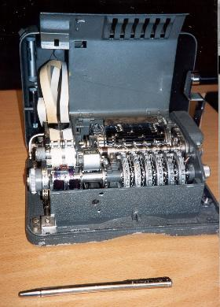
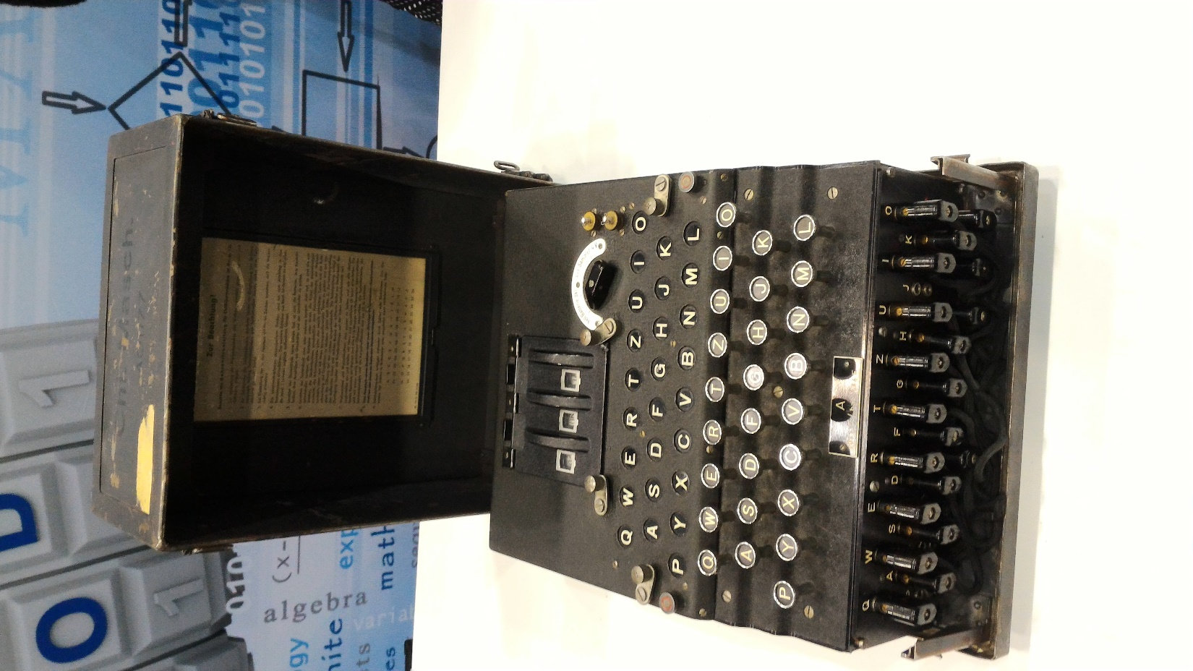
Hagelin Rotor Machine
Enigma Machine
Notes:
Enhanced and Modified by Chuan Yue at the Colorado School of Mines.
This photo of an Allied Hagelin machine was taken by Lawrie Brown at Eurocrypt'93 in Norway. Note pen for scale, and the rotating cipher wheels near the front.
This phone of an Enigma machine was take by Chuan Yue at the National Cyber Security Summit in 2016.

Slide 22
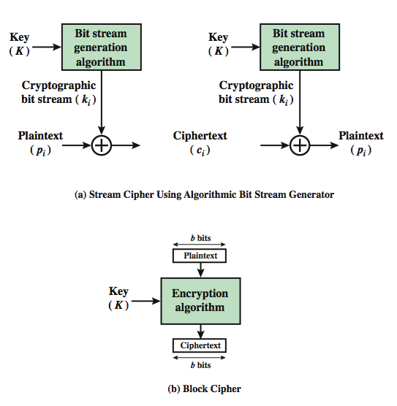
Block vs. Stream Ciphers
keystream
keystream
One-time pad version of Vernam cipher
Notes:
A block cipher is one in which a block of plaintext is treated as a whole and used to produce a ciphertext block of equal length. Typically, a block size of 64 or 128 bits is used. As with a stream cipher, the two users share a symmetric encryption key (Figure 3.1b). A stream cipher is one that encrypts a digital data stream one bit or one byte at a time. In the ideal case, a one-time pad version of the Vernam cipher would be used (Figure 2.7), in which the keystream (k ) is as long as the plaintext bit stream (p).

Slide 23
Data Encryption Standard (DES) History
IBM developed Lucifer cipher in 1971
by team led by Feistel in late 60’s
used 64-bit data blocks with 128-bit key
redeveloped as a commercial 56-bit key cipher (to be used on a chip) with input from NSA and others
in 1973 NBS (now NIST) requested for proposals
IBM submitted their revised Lucifer which was eventually accepted as the DES in 1977
Notes:
In the late 1960s, IBM set up a research project in computer cryptography led by Horst Feistel. The project concluded in 1971 with the development of the LUCIFER algorithm. LUCIFER is a Feistel block cipher that operates on blocks of 64 bits, using a key size of 128 bits.
Because of the promising results produced by the LUCIFER project, IBM embarked on an effort, headed by Walter Tuchman and Carl Meyer, to develop a marketable commercial encryption product that ideally could be implemented on a single chip. It involved not only IBM researchers but also outside consultants and technical advice from NSA. The outcome of this effort was a refined version of LUCIFER that was more resistant to cryptanalysis but that had a reduced key size of 56 bits, to fit on a single chip.
In 1973, the National Bureau of Standards (NBS) issued a request for proposals for a national cipher standard. IBM submitted the modified LUCIFER. It was by far the best algorithm proposed and was adopted in 1977 as the Data Encryption Standard.

Slide 24
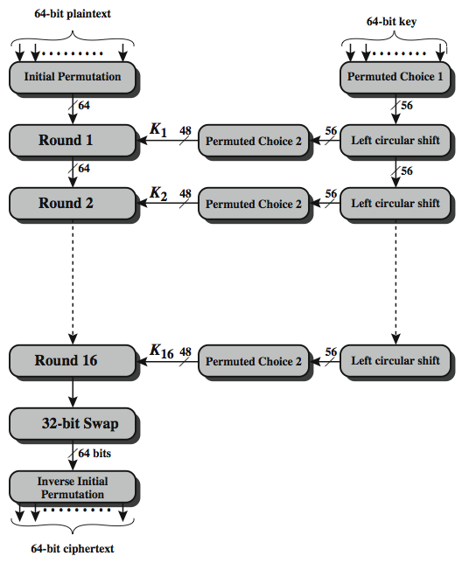
DES Encryption Overview
PC-1: 64 -> 56
PC-2: 56 -> 48
LCS: 1 or 2 bits
Three phases.
Each round: key dependent round function with S and P
Except for IP and IP⁻¹, DES has the exact structure of a Feistel cipher.

Slide 25
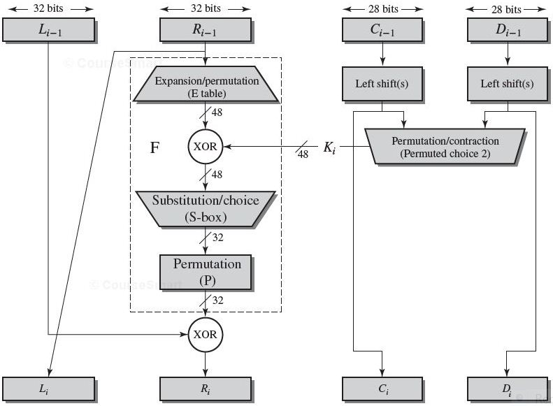
Single Round of DES Algorithm
32 | 1 | 2 | 3 | 4 | 5
4 | 5 | 6 | 7 | 8 | 9
8 | 9 | 10 | 11 | 12 | 13
12 | 13 | 14 | 15 | 16 | 17
16 | 17 | 18 | 19 | 20 | 21
20 | 21 | 22 | 23 | 24 | 25
24 | 25 | 26 | 27 | 28 | 29
28 | 29 | 30 | 31 | 32 | 1
LE_{i}=RE_{i-1};
RE_{i}=LE_{i-1}⊕ F(RE_{i-1,} K_{i} );
Expansion by taking the outer bits from the two adjacent groups (underlined numbers)
16 | 7 | 20 | 21 | 29 | 12 | 28 | 17
1 | 15 | 23 | 26 | 5 | 18 | 31 | 10
2 | 8 | 24 | 14 | 32 | 27 | 3 | 9
19 | 13 | 30 | 6 | 22 | 11 | 4 | 25
Notes:
Stallings Figure 3.6 illustrates the single round of DES algorithm.
F takes 32-bit R half and 48-bit subkey:
expands R to 48-bits using perm E
adds to subkey using XOR
passes through 8 S-boxes to get 32-bit result
finally permutes using 32-bit perm P
We now review the internal structure of the DES round function F, which takes R half & subkey, and processes them. The round key K_{i} is 48 bits. The R input is 32 bits. This R input is first expanded to 48 bits by using a table that defines a permutation plus an expansion that involves duplication of 16 of the R bits (Table 3.2c). The resulting 48 bits are XORed with K_{i} This 48-bit result passes through a substitution function that produces a 32-bit output, which is permuted as defined by Table 3.2d. This follows the classic structure for a feistel cipher.
Note that the s-boxes provide the “confusion” of data and key values, whilst the permutation P then spreads this as widely as possible, so each S-box output affects as many S-box inputs in the next round as possible, giving “diffusion”.

Slide 26
Strength of DES
brute force search is possible
in 1997 on Internet in a few months
in 1998 on dedicated h/w (EFF) in a few days
in 1999 above combined in 22hrs!
cryptanalytic attacks are possible
differential cryptanalysis
observe pairs of text blocks evolving along each round
linear cryptanalysis
find linear approximation to the transformations
related key attacks
observe the operation of a cipher under several related keys
timing attacks are possible
attack actual implementation of a cipher
calculations can take varying times for different inputs
Notes:
Since its adoption as a federal standard, there have been lingering concerns about the level of security provided by DES in two areas: key size and the nature of the algorithm.
With a key length of 56 bits, there are 2⁵⁶ possible keys, which is approximately 7.2*10¹⁶ keys. Thus a brute-force attack appeared impractical.
However DES was finally and definitively proved insecure in July 1998, when the Electronic Frontier Foundation (EFF) announced that it had broken a DES encryption using a special-purpose "DES cracker" machine that was built for less than $250,000. The attack took less than three days. The EFF has published a detailed description of the machine, enabling others to build their own cracker [EFF98].
There have been other demonstrated breaks of the DES using both large networks of computers & dedicated h/w, including:
- 1997 on a large network of computers in a few months
- 1998 on dedicated h/w (EFF) in a few days
- 1999 above combined in 22hrs!
It is important to note that there is more to a key-search attack than simply running through all possible keys. Unless known plaintext is provided, the analyst must be able to recognize plaintext as plaintext.
Clearly must now consider alternatives to DES, the most important of which are AES and triple DES.

Slide 27
AES Origins
clearly a replacement for DES was needed
have theoretical attacks that can break it
have demonstrated exhaustive key search attacks
can use Triple-DES – but slow, has small blocks
US NIST issued call for ciphers in 1997
15 candidates accepted in June 1998
5 were shortlisted in August 1999
Rijndael (designed by Rijmen and Daemen in Belgium) was selected as the AES in Oct-2000
issued as FIPS PUB 197 standard in Nov-2001
Notes:
The Advanced Encryption Standard (AES) was published by NIST (National Institute of Standards and Technology) in 2001. AES is a symmetric block cipher that is intended to replace DES as the approved standard for a wide range of applications. The AES cipher (& other candidates) form the latest generation of block ciphers, and now we see a significant increase in the block size - from the old standard of 64-bits up to 128-bits; and keys from 128 to 256-bits. In part this has been driven by the public demonstrations of exhaustive key searches of DES. Whilst triple-DES is regarded as secure and well understood, it is slow, especially in s/w. In a first round of evaluation, 15 proposed algorithms were accepted. A second round narrowed the field to 5 algorithms. NIST completed its evaluation process and published a final standard (FIPS PUB 197) in November of 2001. NIST selected Rijndael as the proposed AES algorithm. The two researchers who developed and submitted Rijndael for the AES are both cryptographers from Belgium: Dr. Joan Daemen and Dr.Vincent Rijmen.

Slide 28
The AES Main Points
has 128/192/256 bit keys, 128 bit block size (16 bytes)
an iterative rather than Feistel cipher
processes data as block of 4 columns of 4 bytes
operates on entire data block (not half-half) in every round
all operations are performed on 8-bit bytes
the arithmetic operations of addition, multiplication, and division are performed over the finite field GF (2⁸), with the irreducible polynomial m(x) = x⁸ + x⁴ + x³ + x + 1
designed to be:
resistant against known attacks
speed and code compactness on many CPUs
design simplicity
Notes:
The Rijndael proposal for AES defined a cipher in which the block length and the key length can be independently specified to be 128,192,or 256 bits. The AES specification uses the same three key size alternatives but limits the block length to 128 bits. Rijndael is an academic submission, based on the earlier Square cipher, from Belgium academics Dr Joan Daemen and Dr Vincent Rijmen. It is an iterative cipher (operates on entire data block in every round) rather than feistel (operate on halves at a time), and was designed to have characteristics of: Resistance against all known attacks, Speed and code compactness on a wide range of platforms, & Design simplicity.

Slide 29
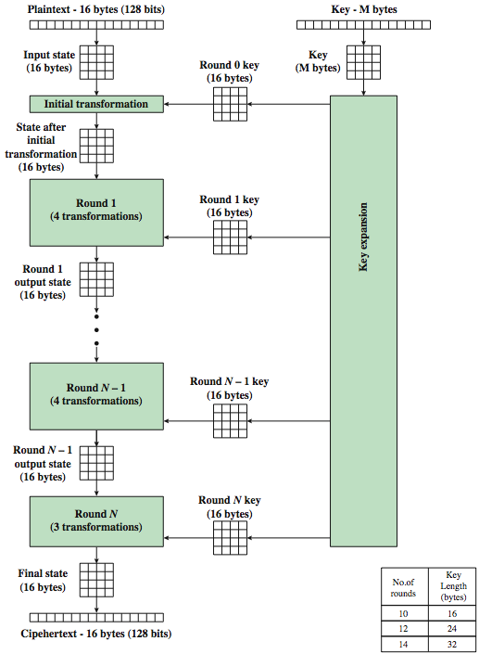
AES Encryption Process
The byte ordering is by column for both the data and key
State array holds data
Key expansion function generates N+1 round keys
128-bit key length:
expanded into 44 32-bit words
First N-1 round: 4 transformations; Final round: 3 transformations.
Each round:
4x4 state → 4x4 state
Number of rounds relates to key length

Slide 30
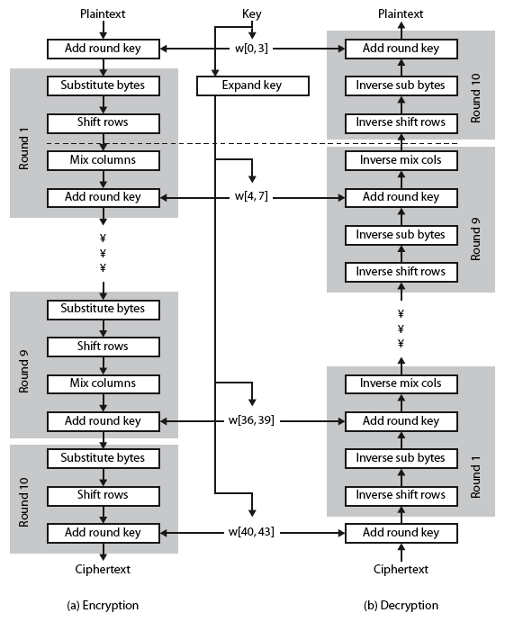
AES Structure in Detail (128-bit key)
Substitute Bytes: one S-box used on every byte-by-byte substitution
ShiftRows: a simple permutation
MixColumns: a substitution makes use of arithmetic over GF(2⁸)
AddRoundKey: a simple substitution (XOR state with key)
XOR encryption (AddRoundKey), followed by scrambling of the block (the other three stages), followed by XOR encryption, and so on. Each stage is reversible.
Decryption & encryption are not identical

Slide 31
Modes of Operation
block ciphers encrypt fixed size blocks
eg. DES encrypts 64-bit blocks with 56-bit key
encrypt arbitrary amounts of data with same key
many security issues
NIST SP 800-38A defines 5 modes of operation
Electronic Codebook (ECB), Cipher Block Chaining (CBC), Cipher Feedback (CFB), Output Feedback (OFB), Counter (CTR) mode
techniques for security or for practical applications
e.g., apply block ciphers to a sequence of data blocks/stream
cover a wide variety of applications
can be used with any block cipher
Notes:
DES (or any block cipher) forms a basic building block, which en/decrypts a fixed sized block of data. However to use these in practise, we usually need to handle arbitrary amounts of data, which may be available in advance (in which case a block mode is appropriate), and may only be available a bit/byte at a time (in which case a stream mode is used). To apply a block cipher in a variety of applications, five "modes of operation" have been defined by NIST (SP 800-38A). In essence, a mode of operation is a technique for enhancing the effect of a cryptographic algorithm or adapting the algorithm for an application, such as applying a block cipher to a sequence of data blocks or a data stream. The five modes are intended to cover a wide variety of applications of encryption for which a block cipher could be used. These modes are intended for use with any symmetric block cipher, including triple DES and AES. .

Slide 32
Summary
Terms and Classifications
Classical Substitution Ciphers
Classical Transposition Ciphers
Product Ciphers
DES, AES

